Slide 1
LAPR2 Project
Payments Management

Slide 2
Introduction
What was the problem?
What solution did we produced?

Slide 3
What was the problem?
T4J
Administrator
Collaborator
Manager
Add new organizations, managers and collaborators
Create tasks, freelancers and payment transactions
See the performance of the freelancers
Define automatic payments date
Load files
Notify freelancers about their delay times

Slide 4
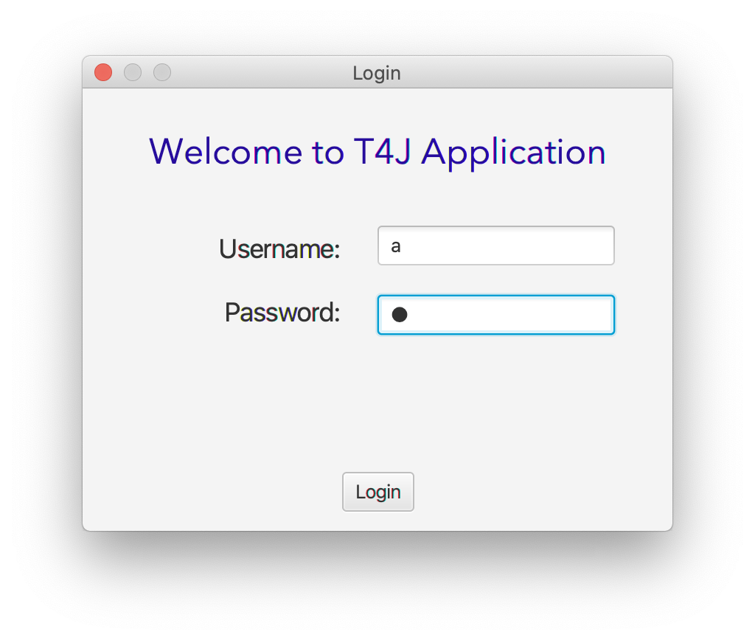
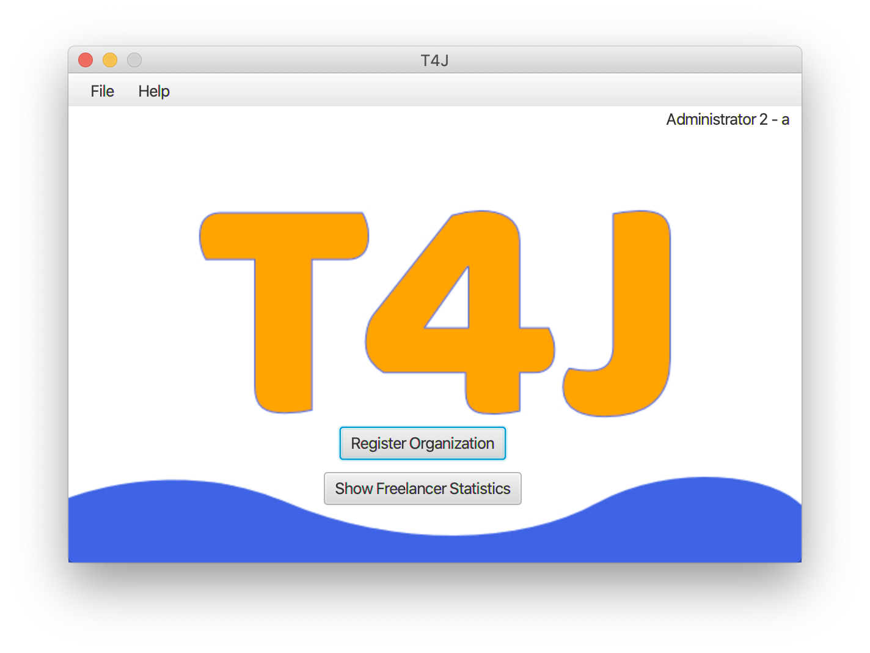
What solution did we produced?

Slide 5
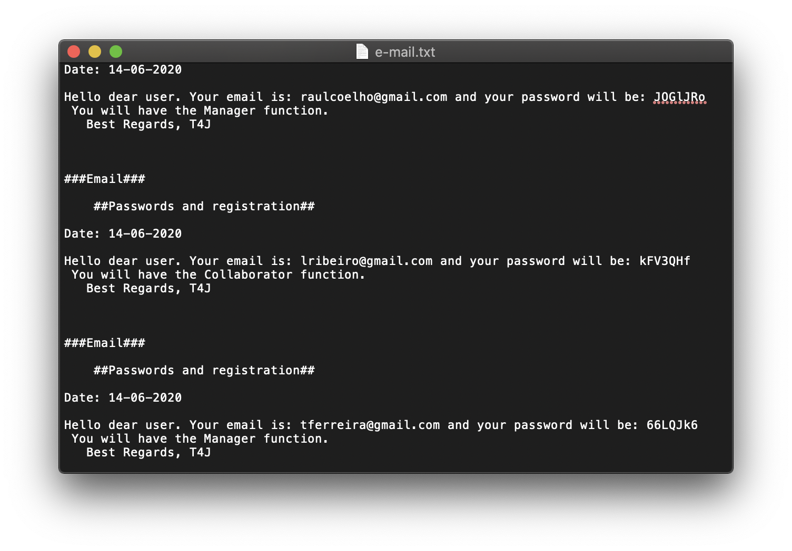
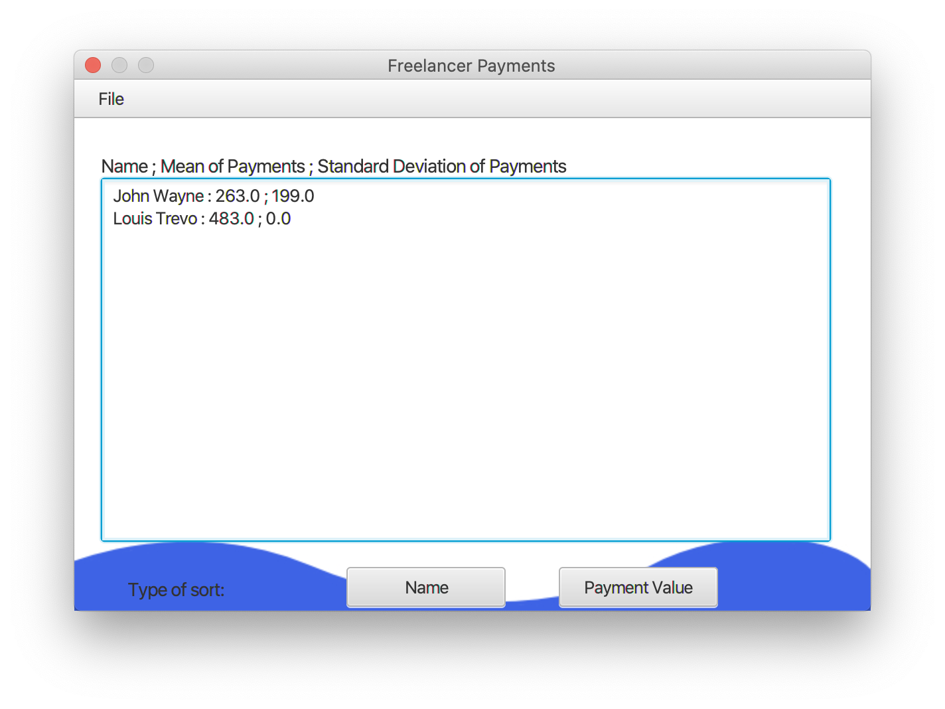
What solution did we produced?

Slide 6
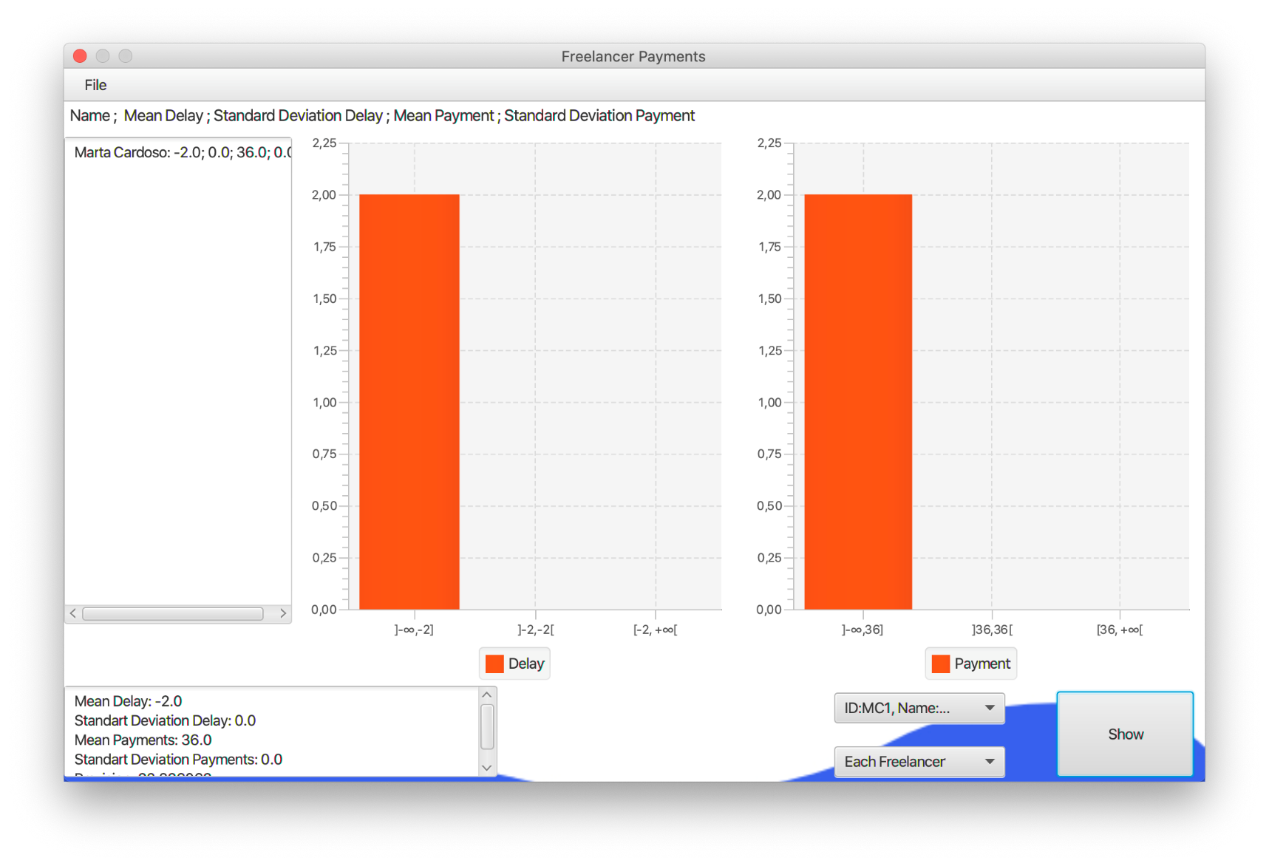
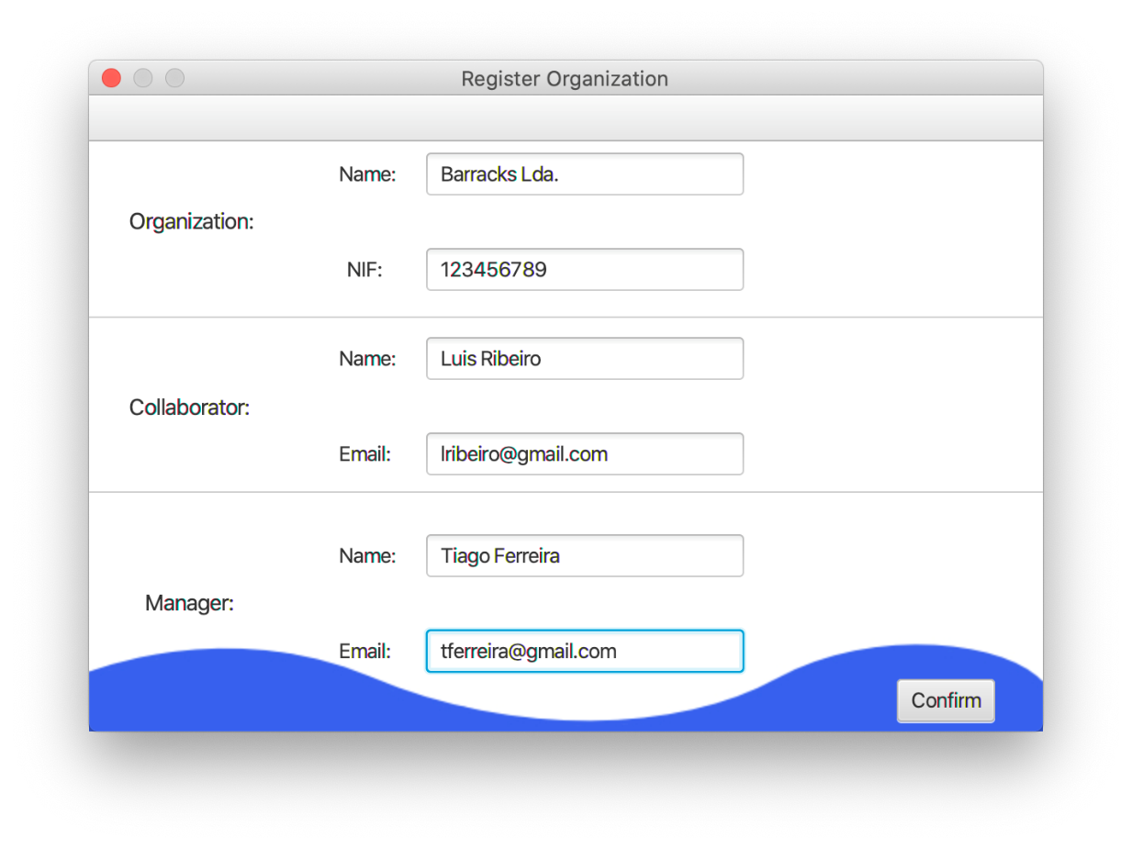
What solution did we produced?

Slide 7
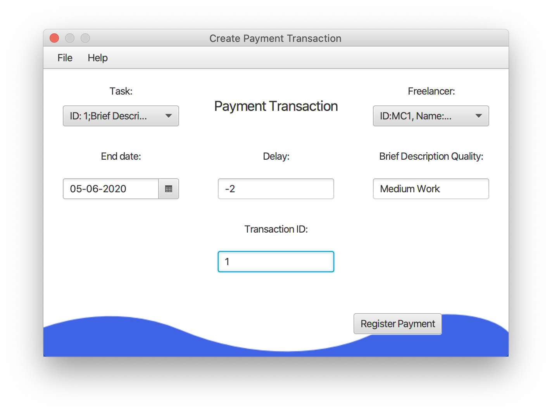
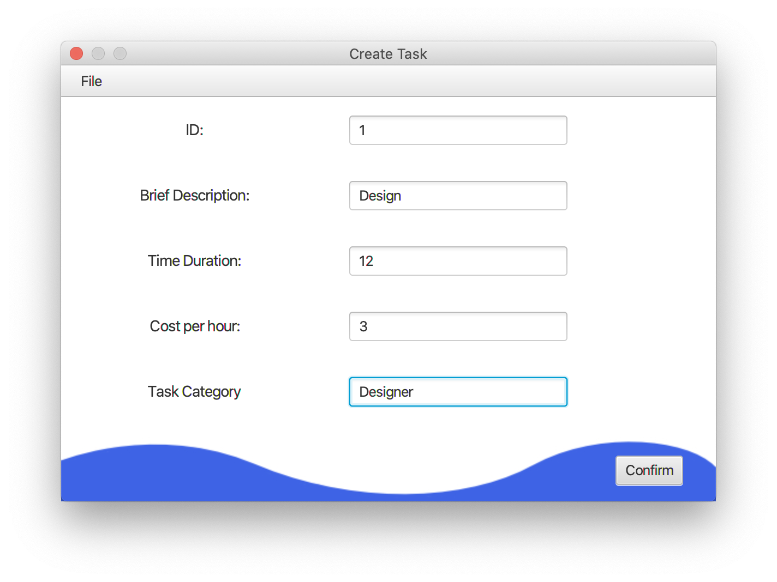
What solution did we produced?

Slide 8
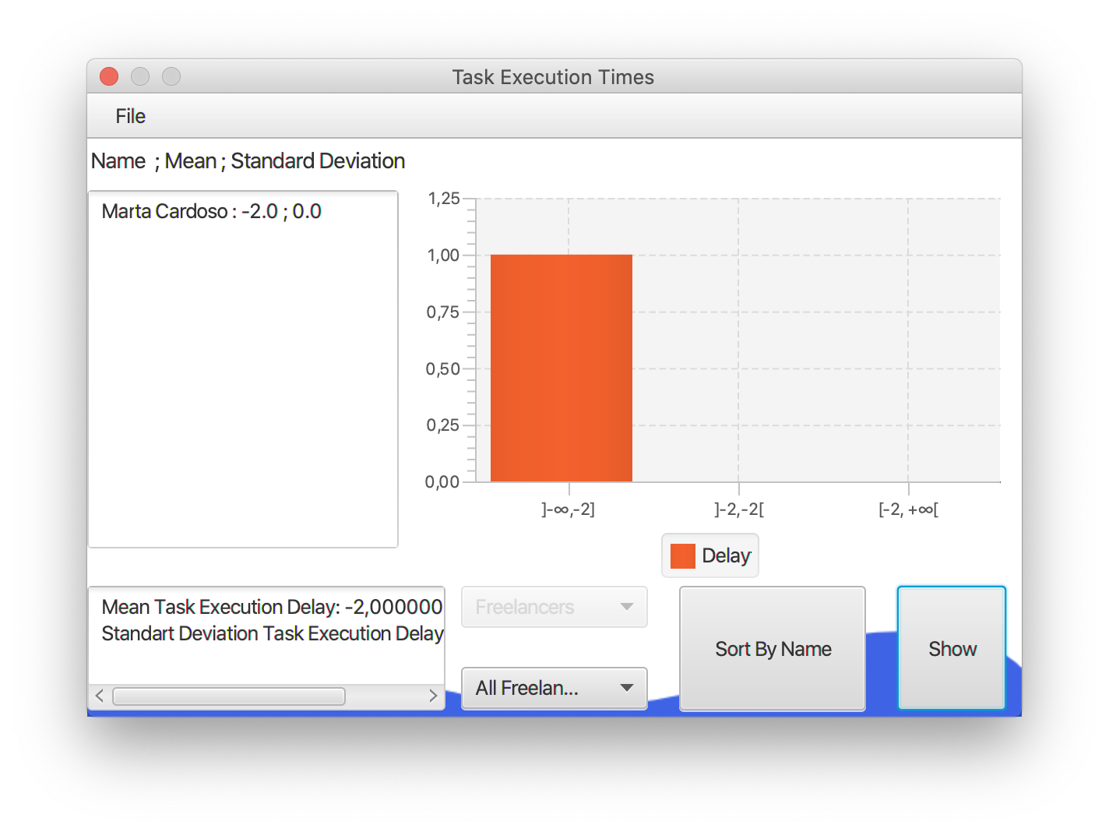
What solution did we produced?

Slide 9
THANK
YOU

Slide 10
The End
Team 43
1190778 - José Silva
1190780 - José Forno
1190986 - Raúl Coelho
1191051 - Sandro Moura
1191091 - Tiago Magalhães

